Slide 1
Markov decision process practice
Reinforcement Learning
鄢忻媛
Feb, 20th, 2021
xinyuanyan2016@gmail.com

Slide 2
Outline
Solving all exercises in chapter 3
(including Bellman equation derivation)
Bonus: solving cliff world question

Slide 3
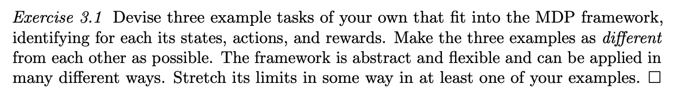
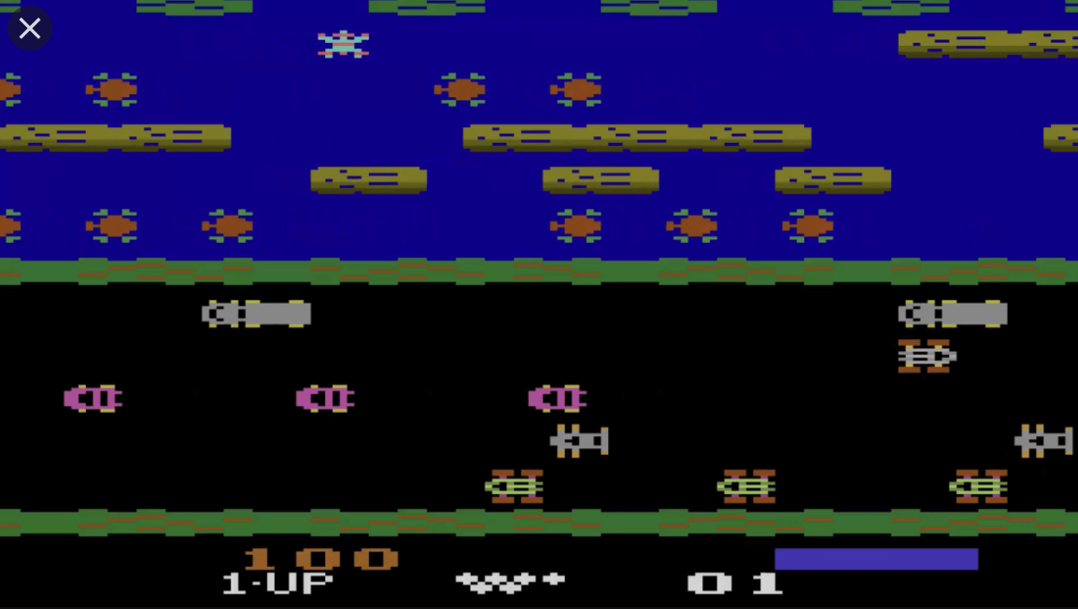
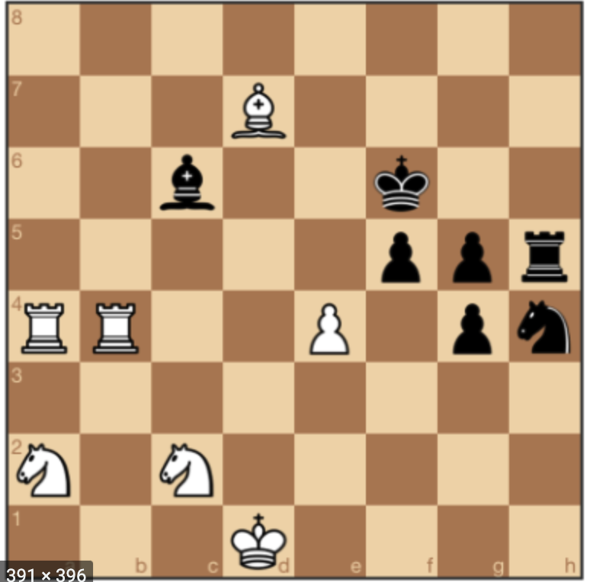
Self Driving Car
Atari game
Chess game

Slide 4
No.
For questions without fully observed states, MDP framework was not longer useful
Card game (e.g.)

Slide 5
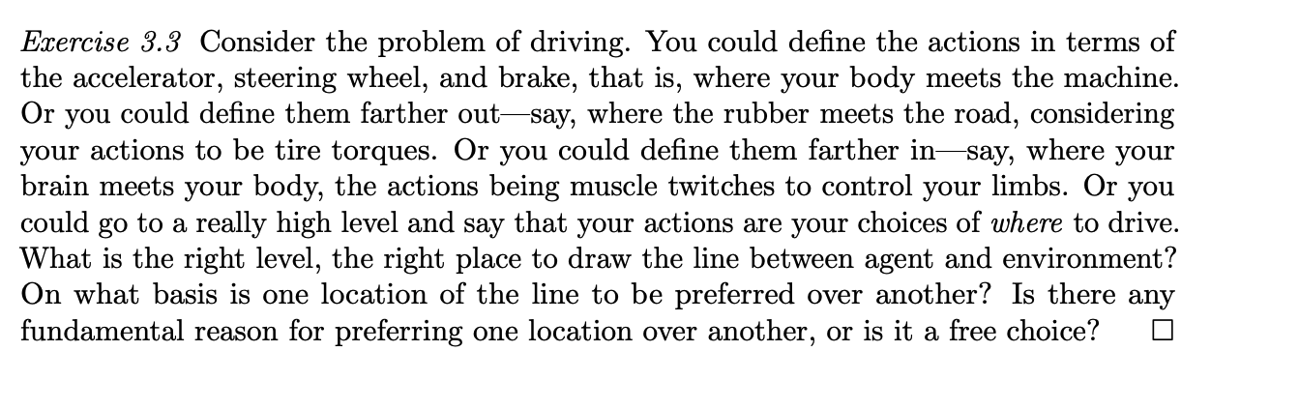

Slide 6
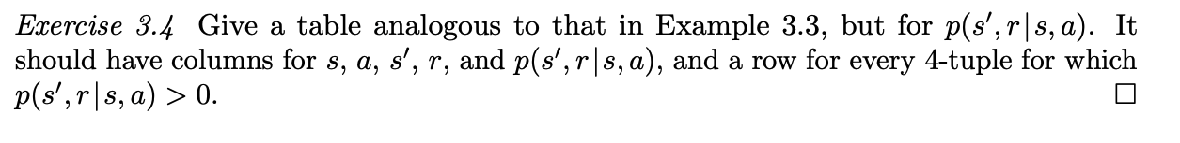
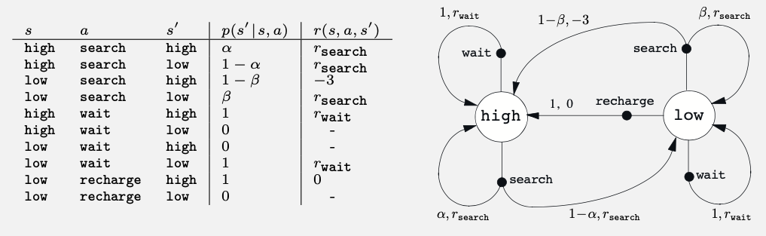
p52 example 3.3

Slide 7
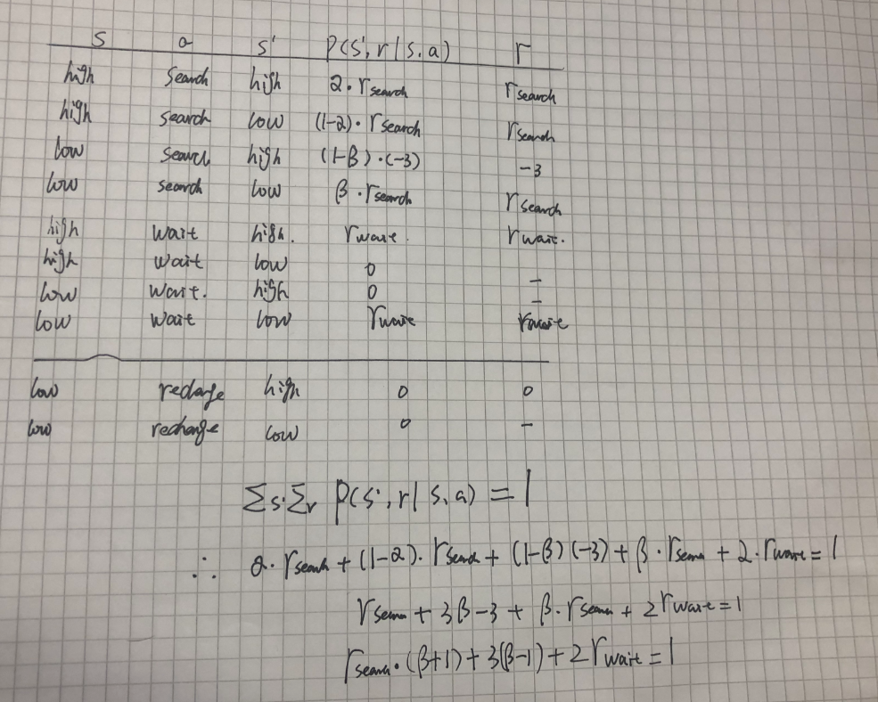

Slide 8
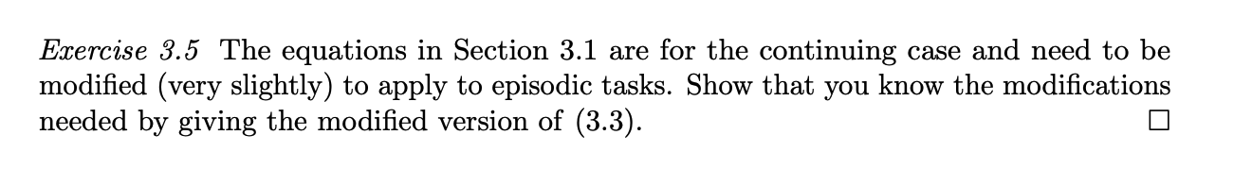

Slide 9
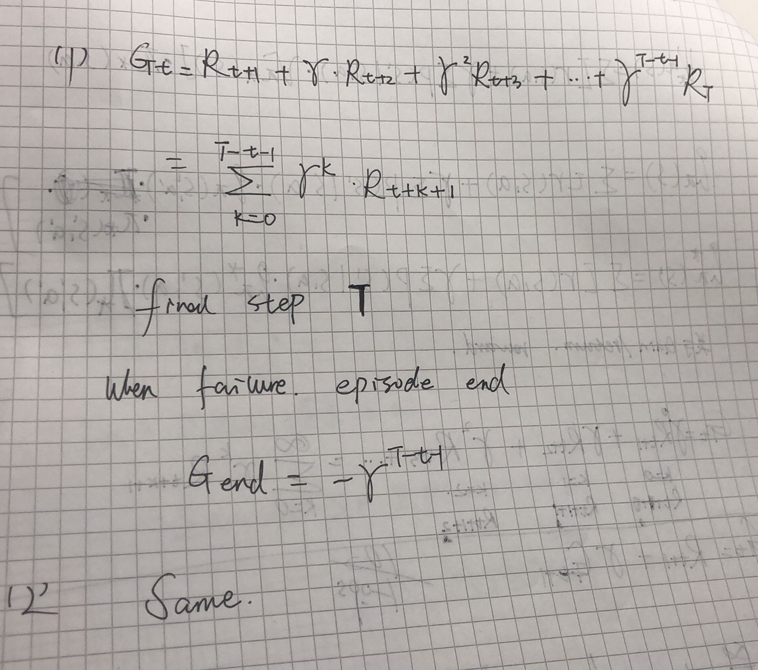
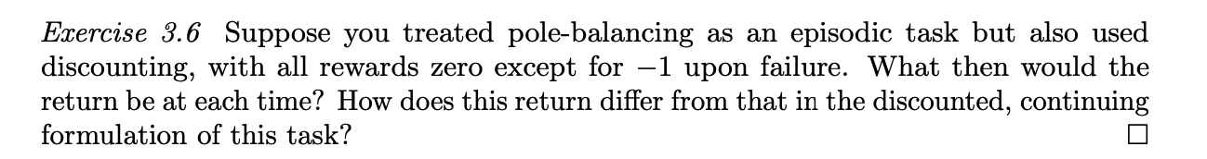

Slide 10
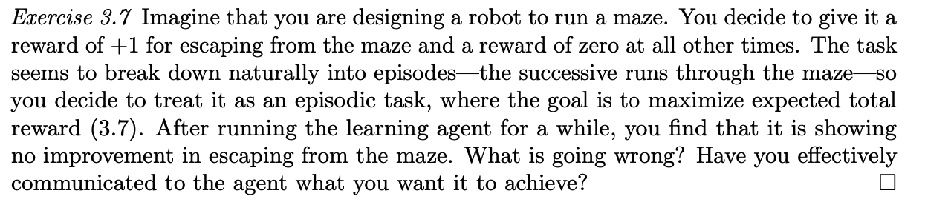
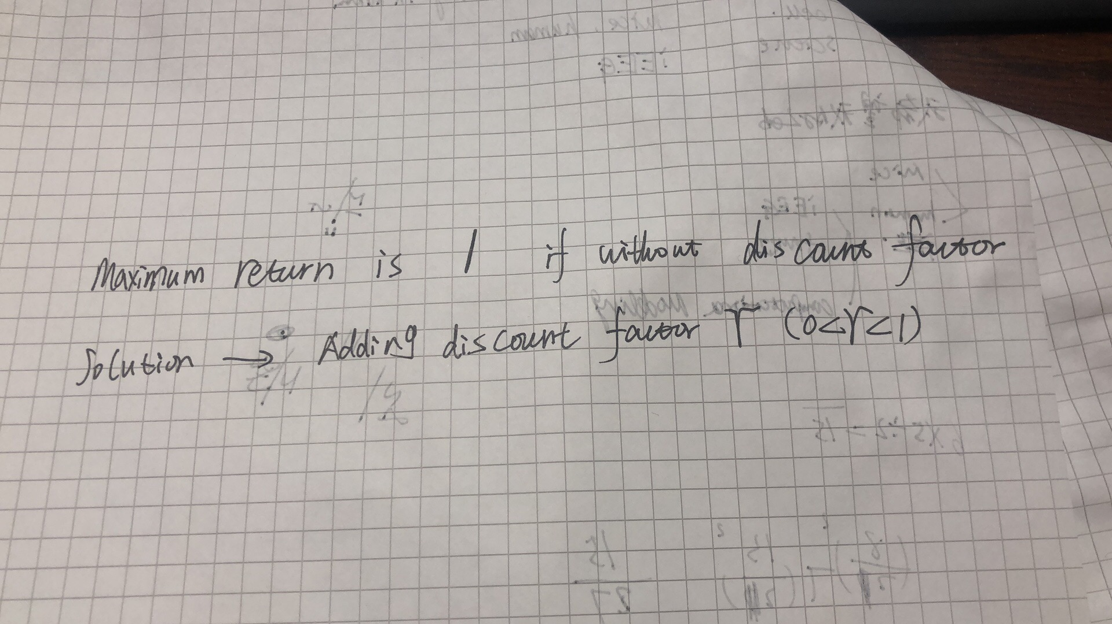

Slide 11
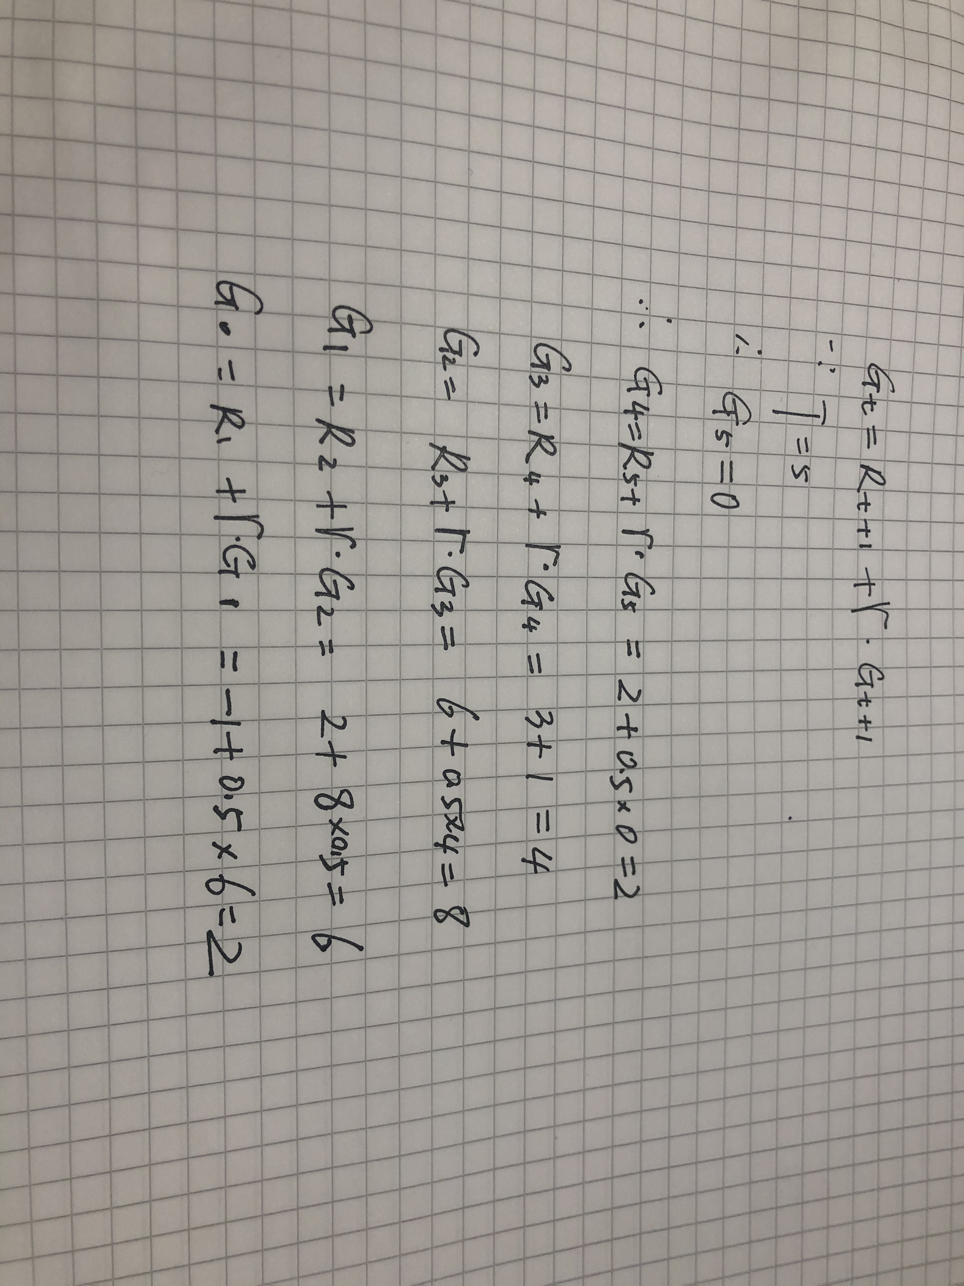

Slide 12
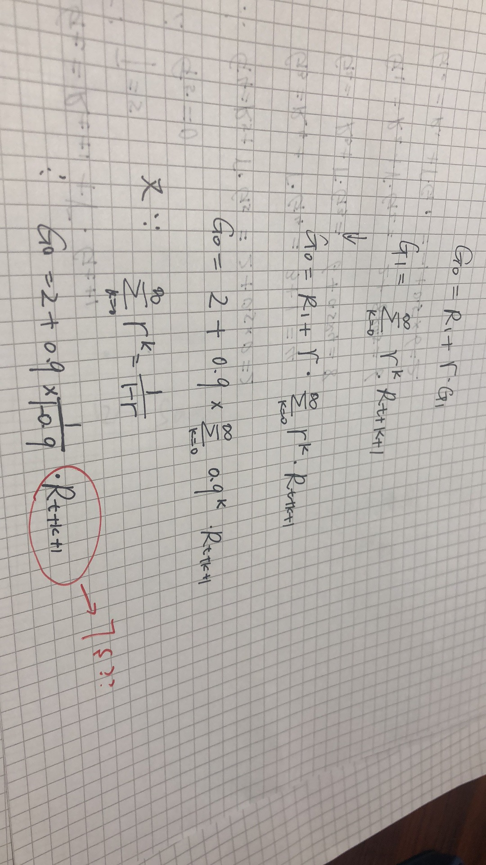

Slide 13
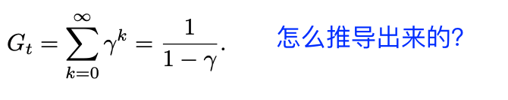
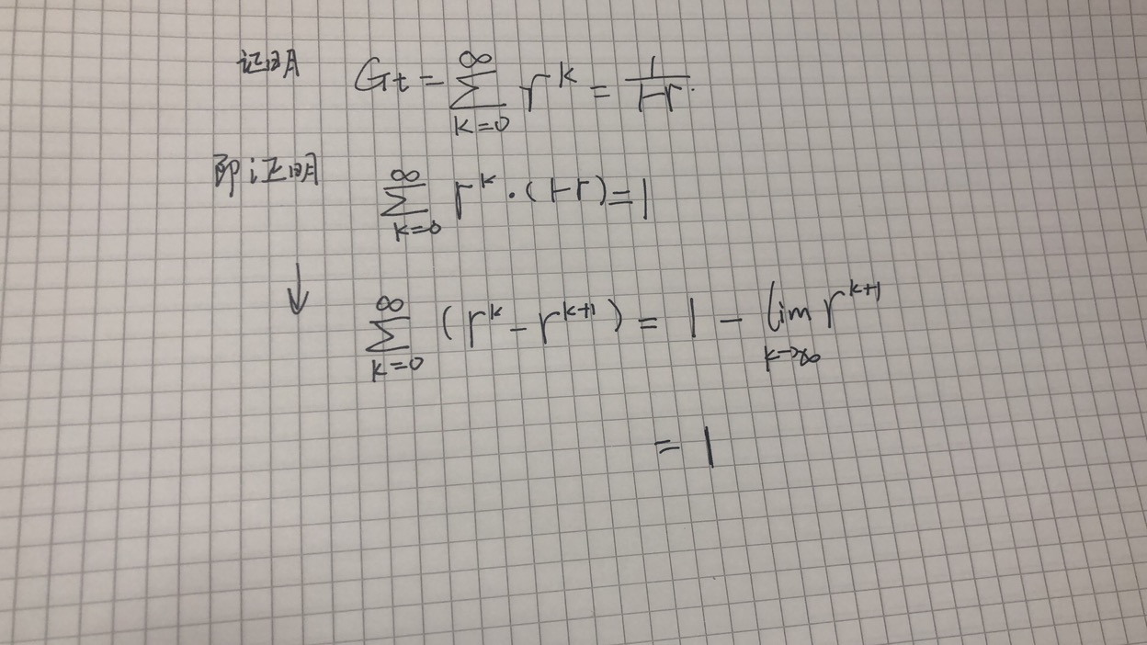

Slide 14
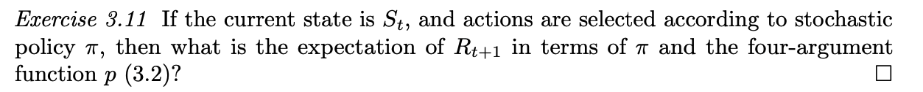
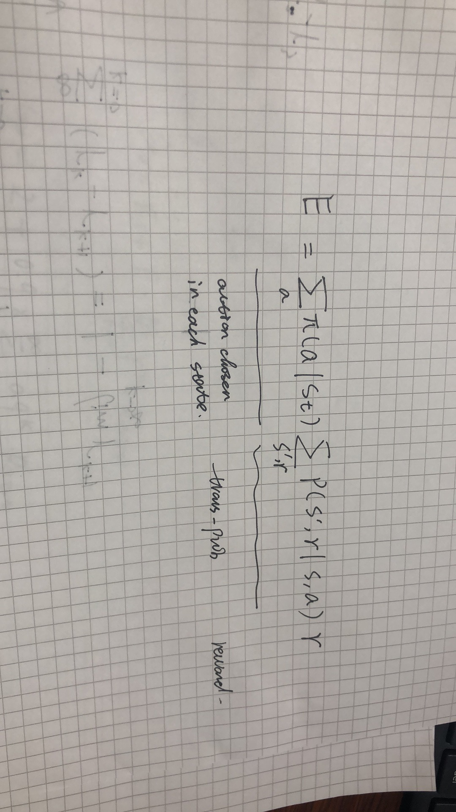

Slide 15
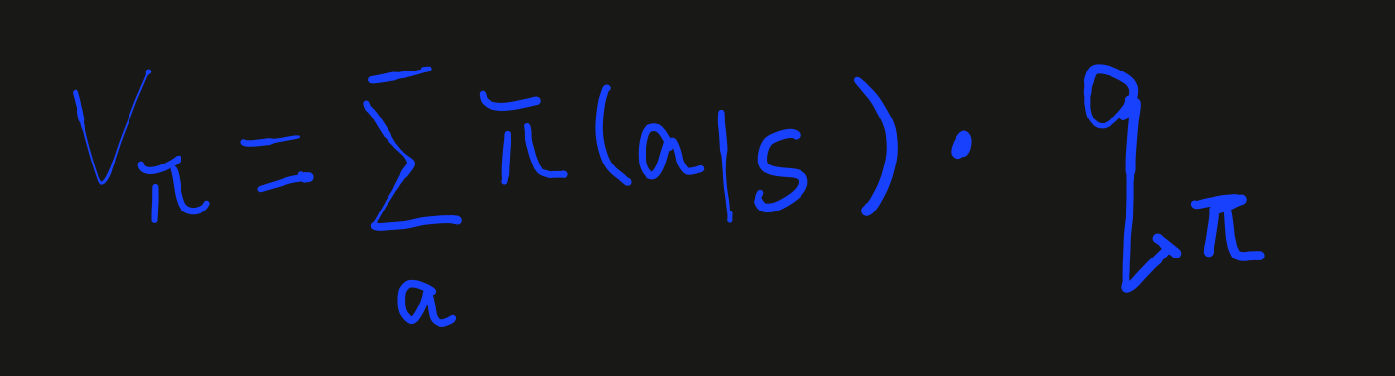
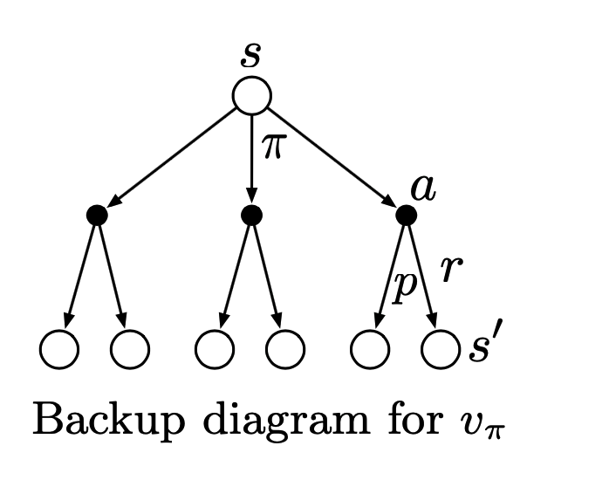
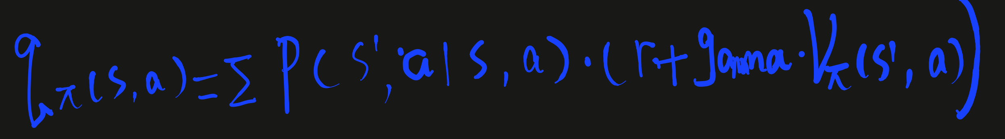

Slide 16
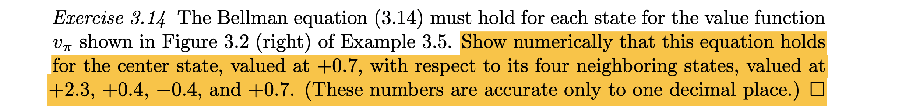
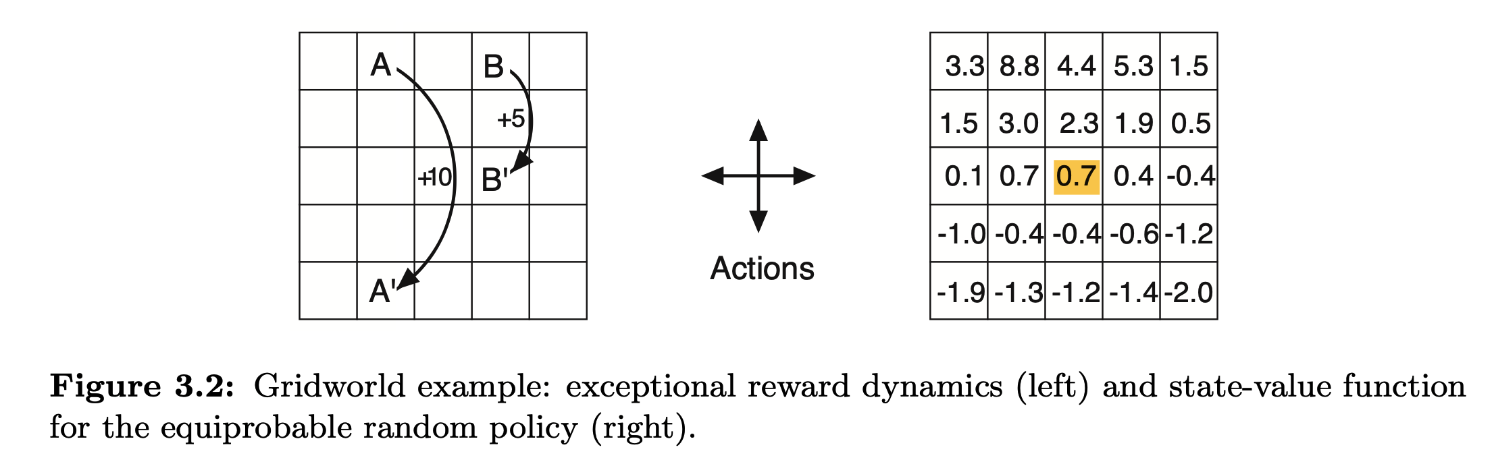

Slide 17
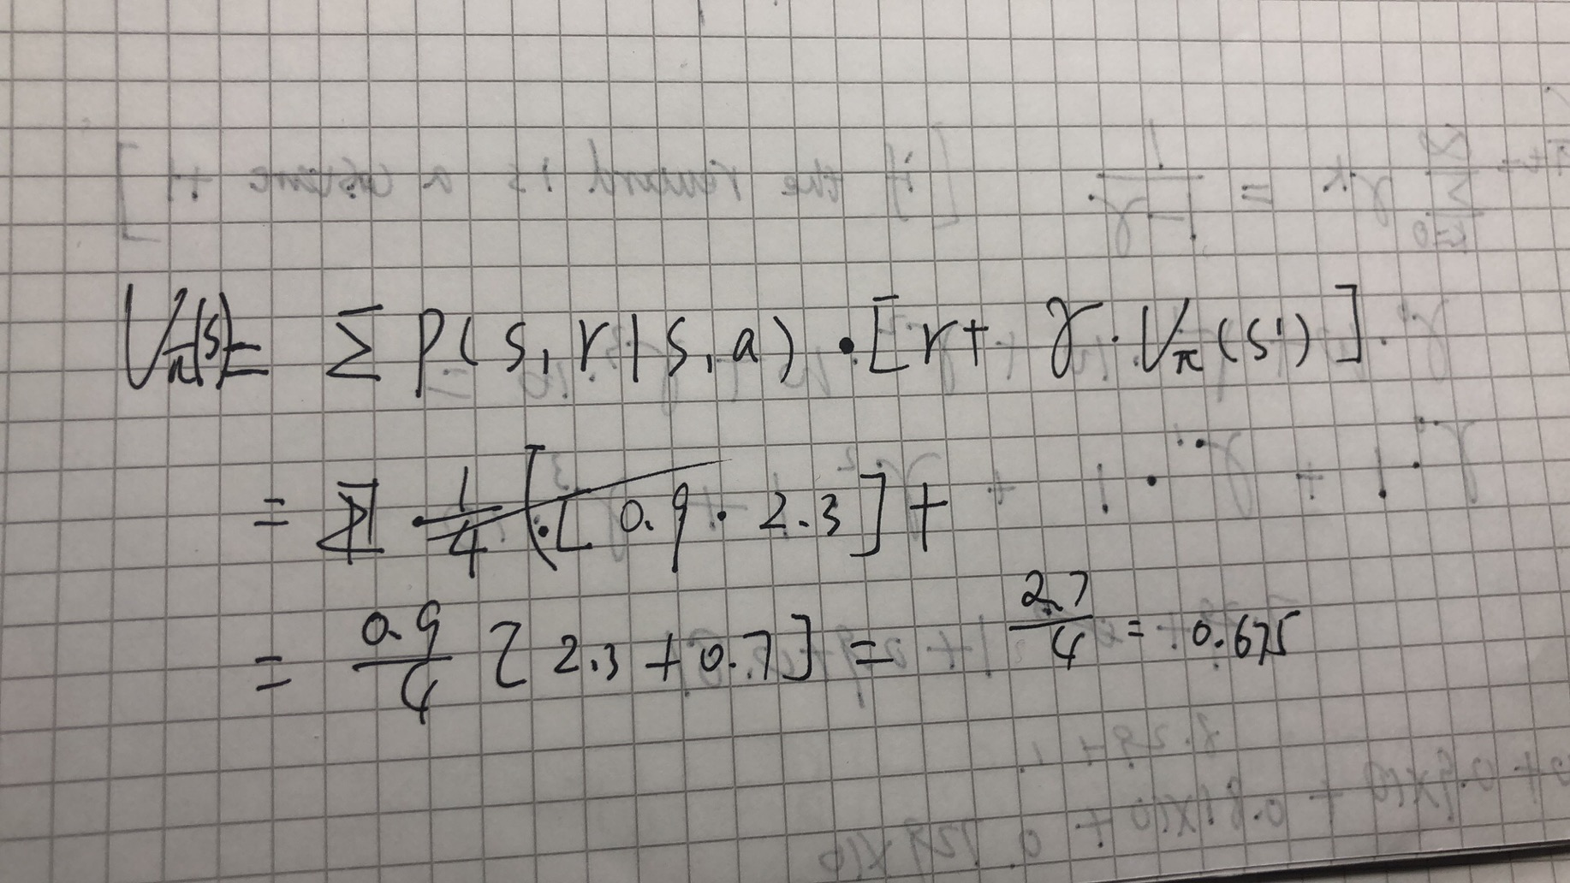

Slide 18
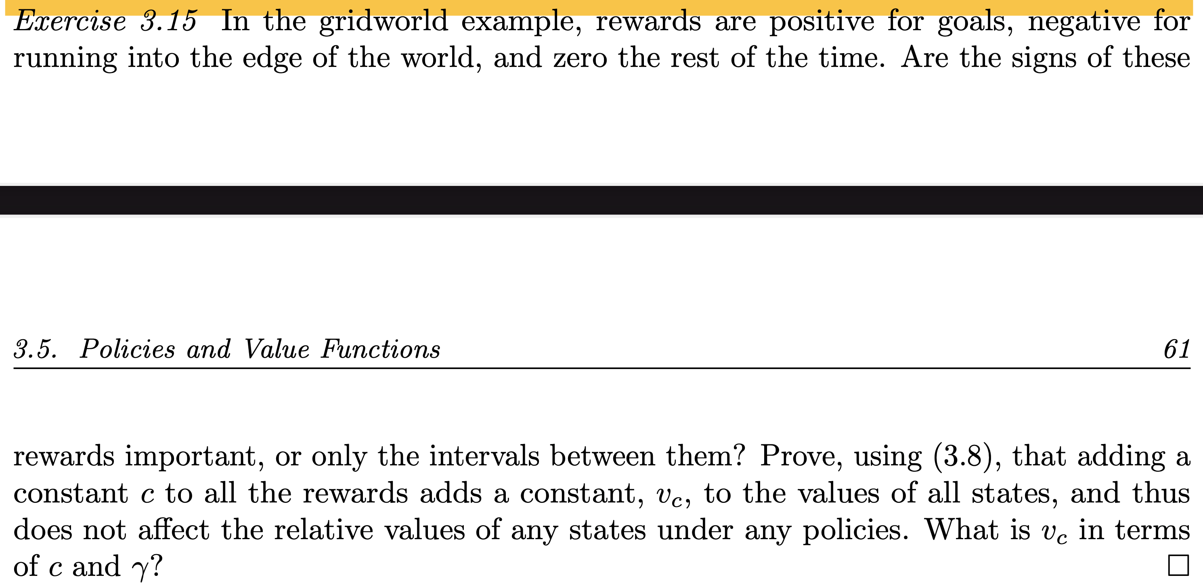

Slide 19
Adding constant C on the reward, it would influence the learning process of agent
If the negative reward is not so “negative”, the agent may not “think”that taking wrong
step would be bad.

Slide 20
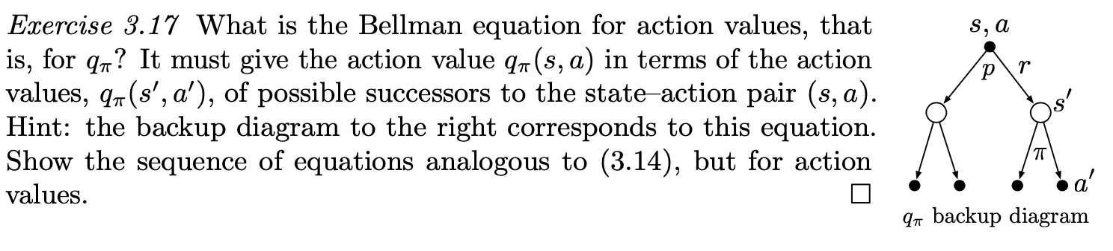
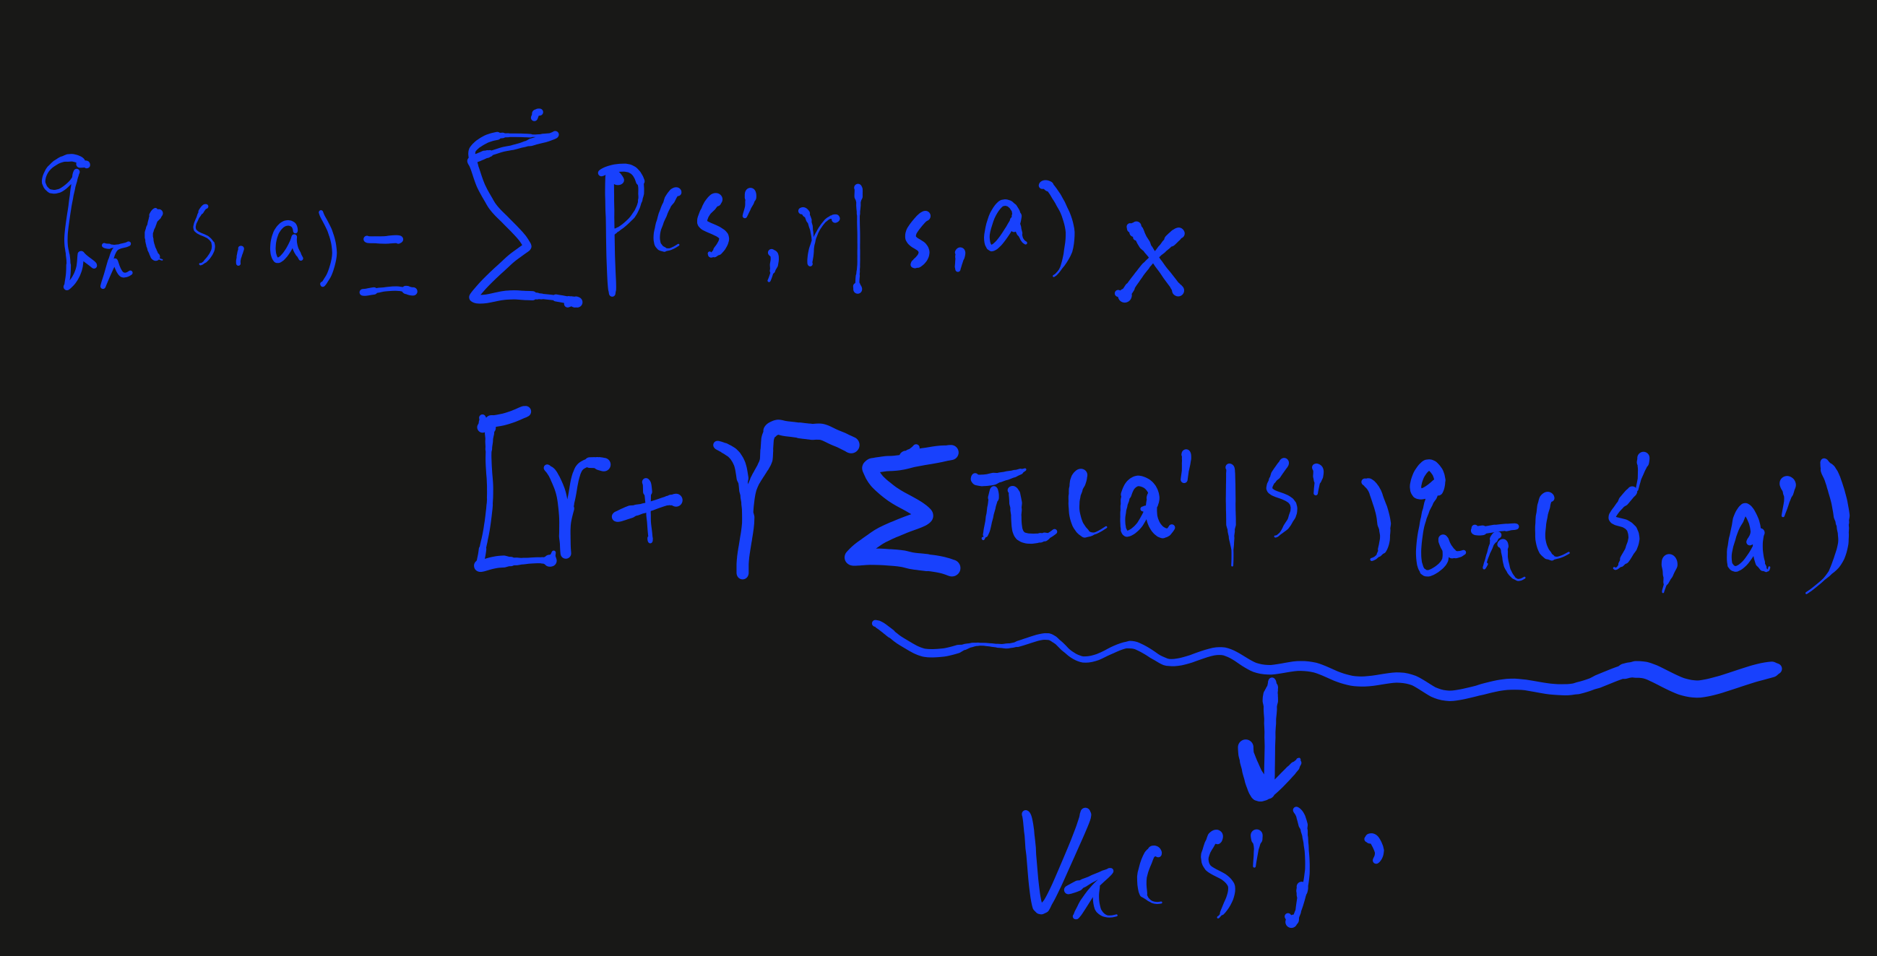

Slide 21
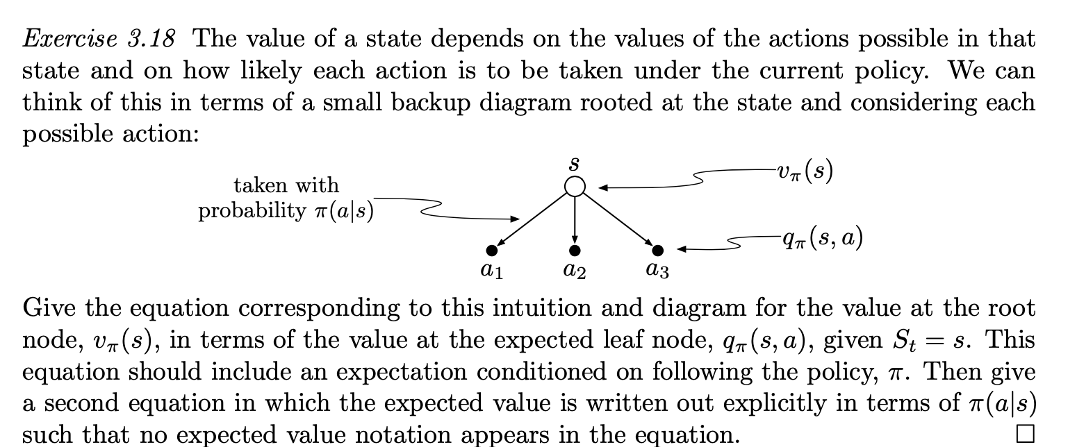
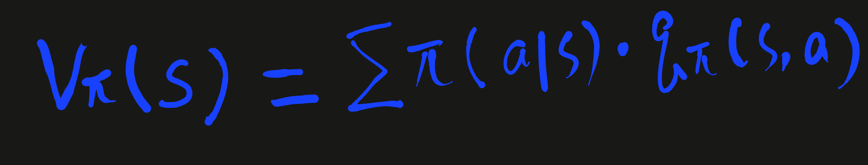

Slide 22
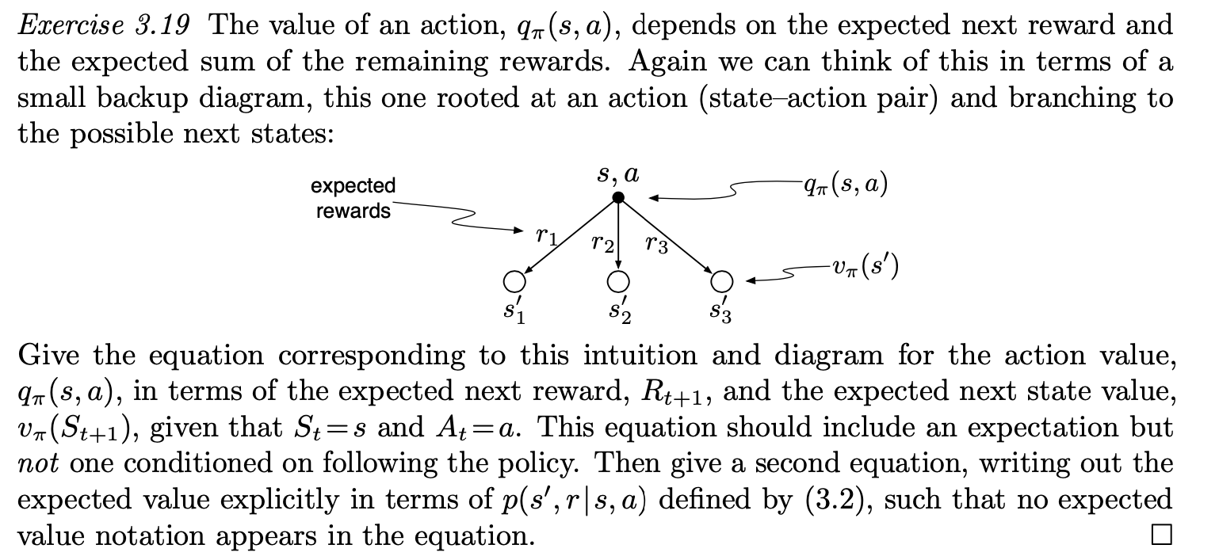
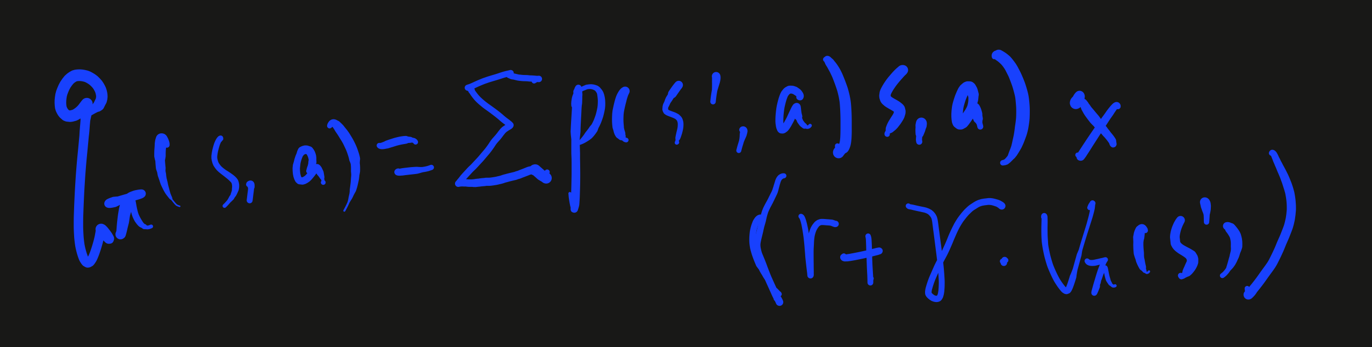

Slide 23
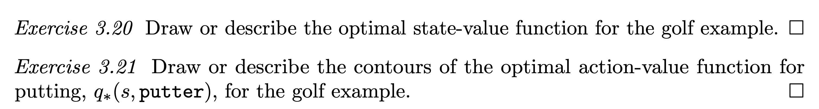
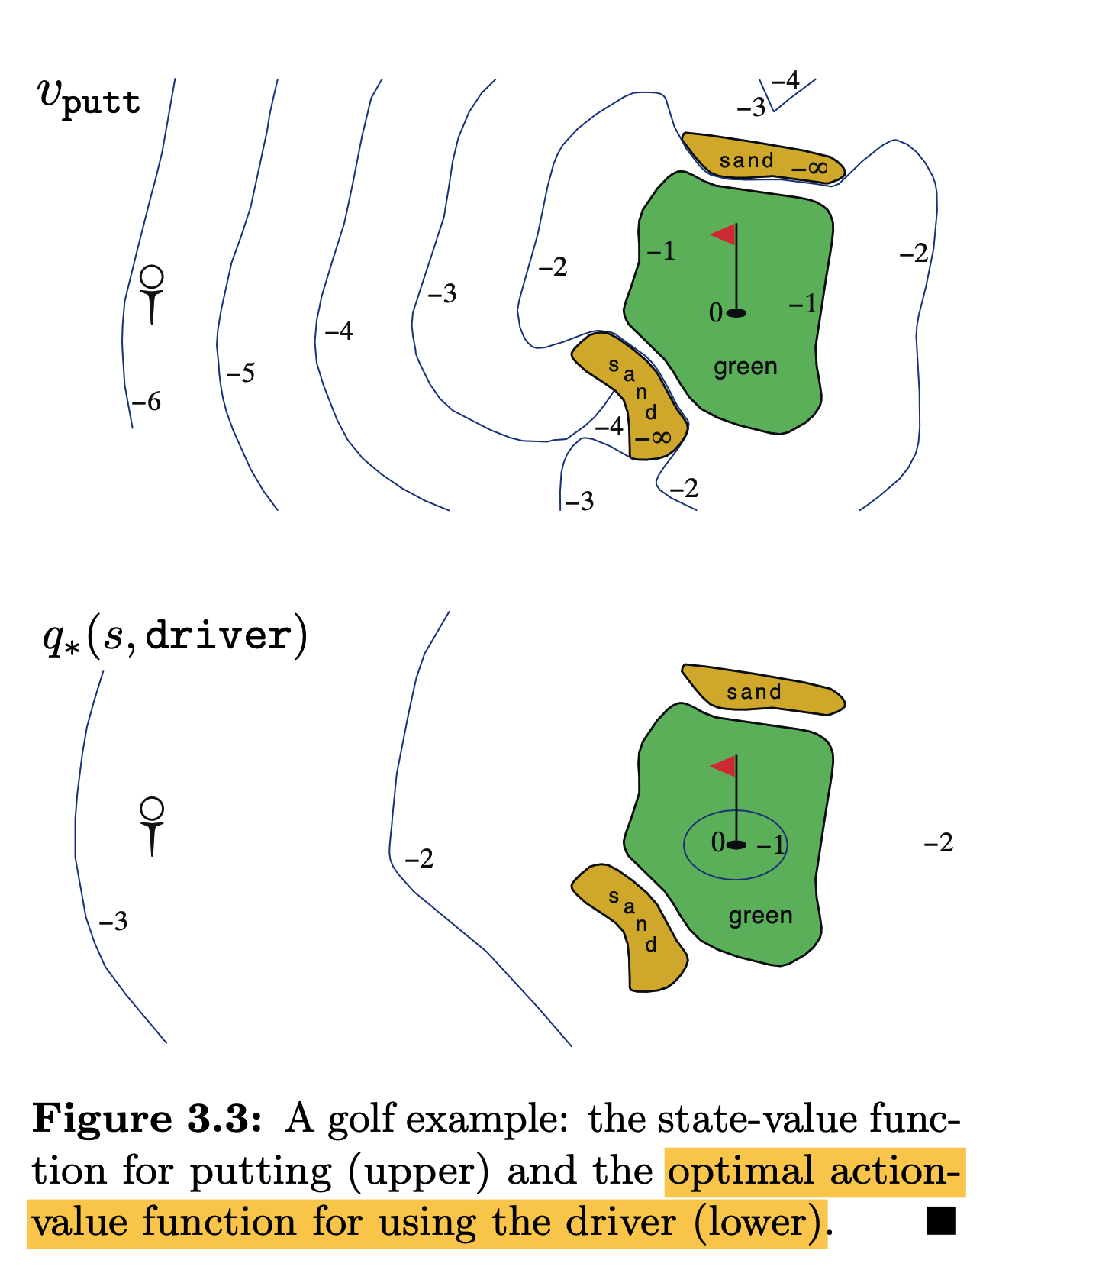
Golf example see book p61

Slide 24
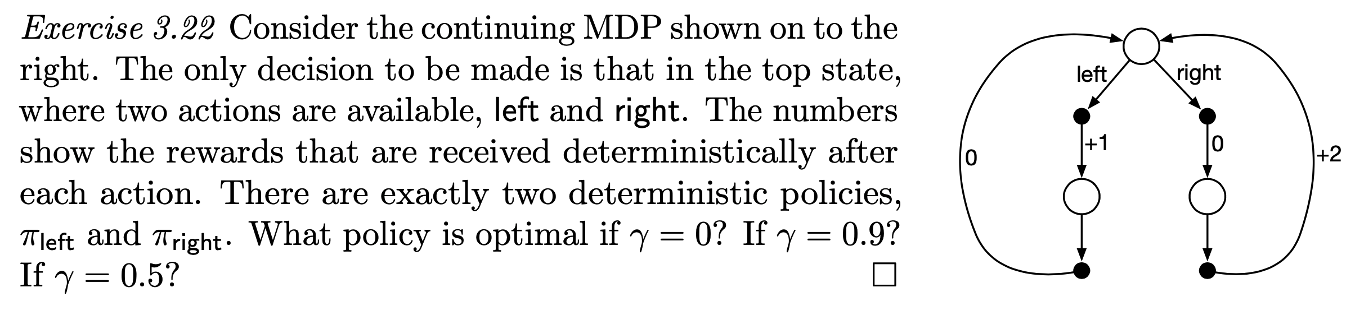

Slide 25
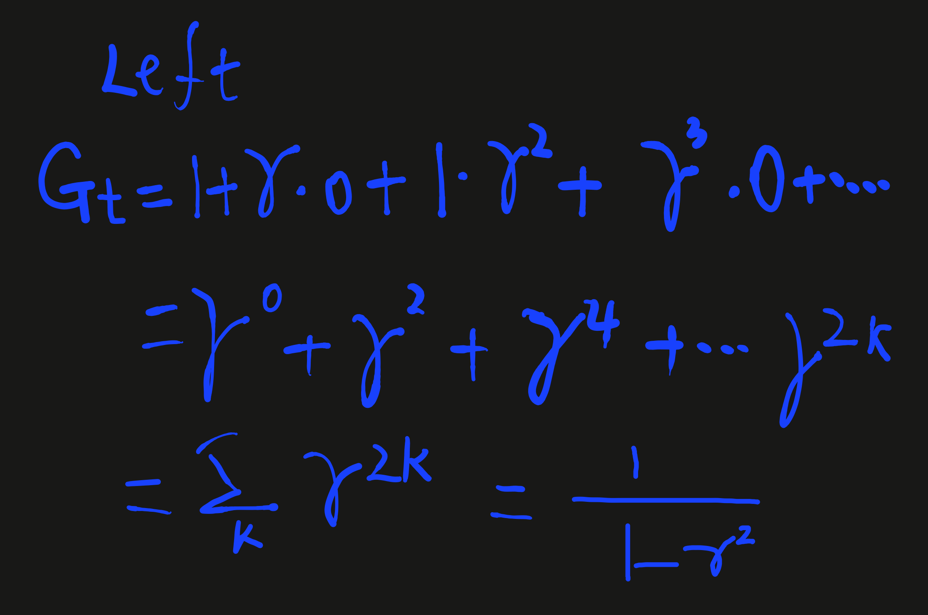
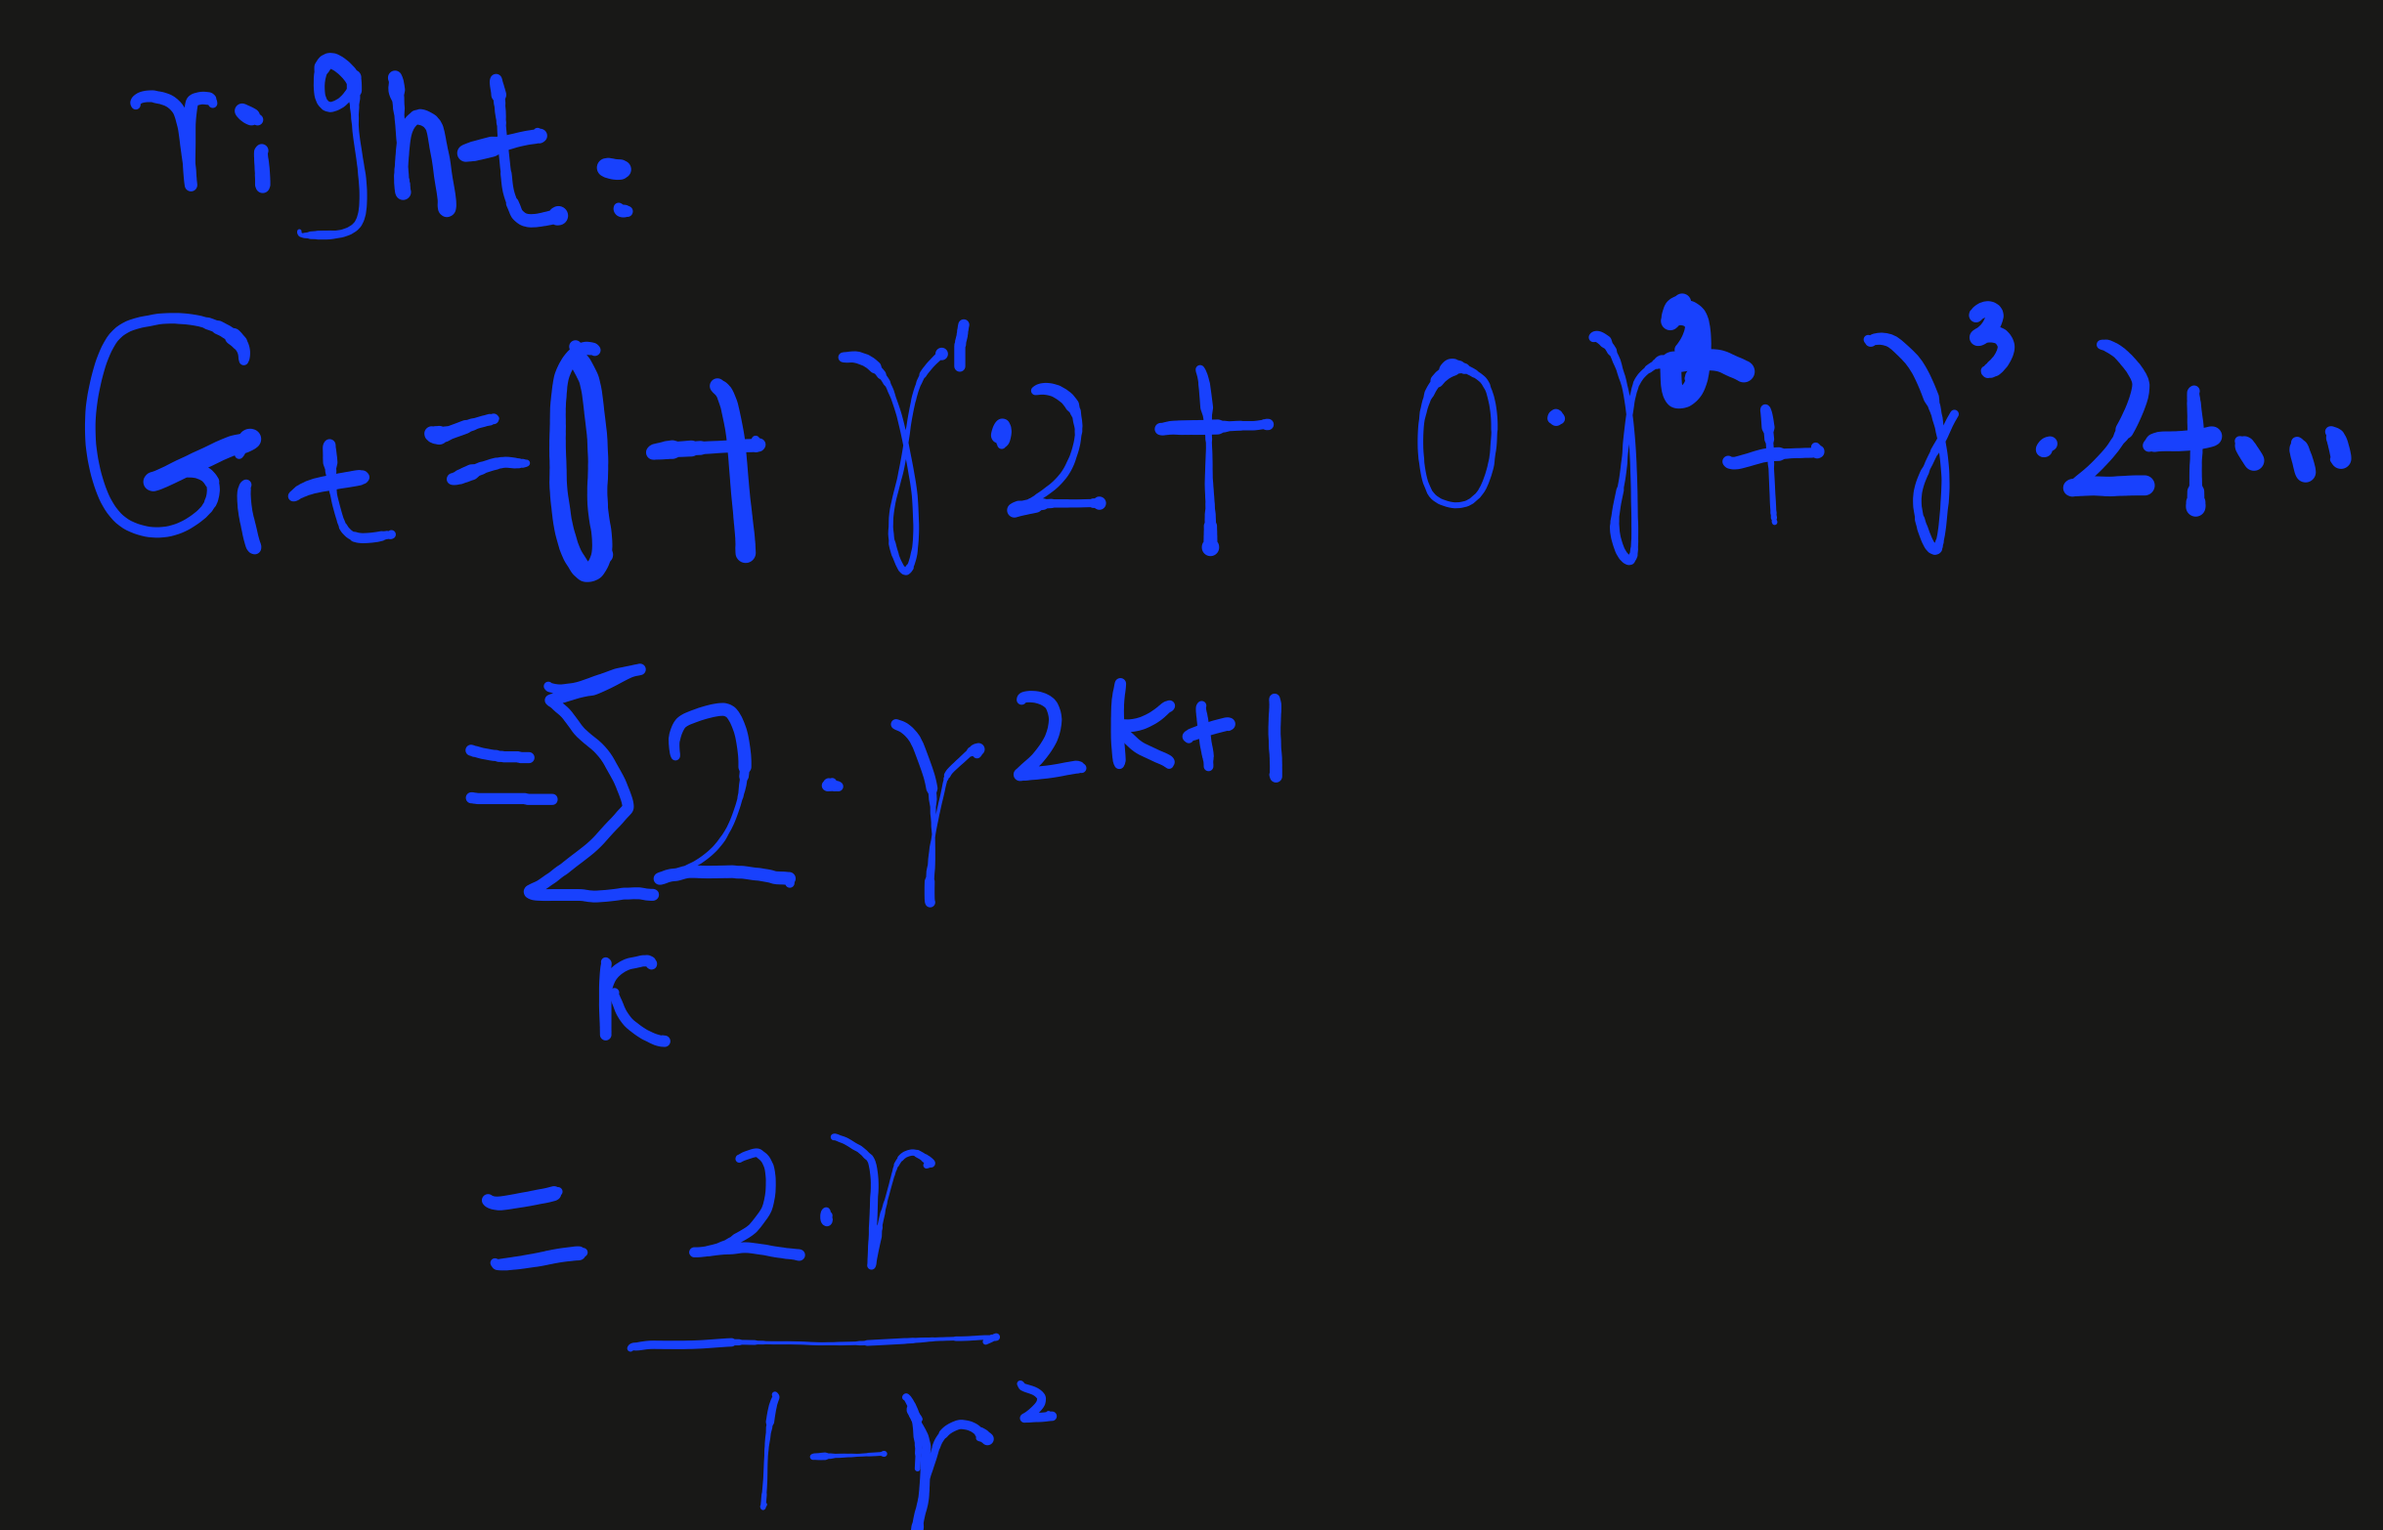

Slide 26
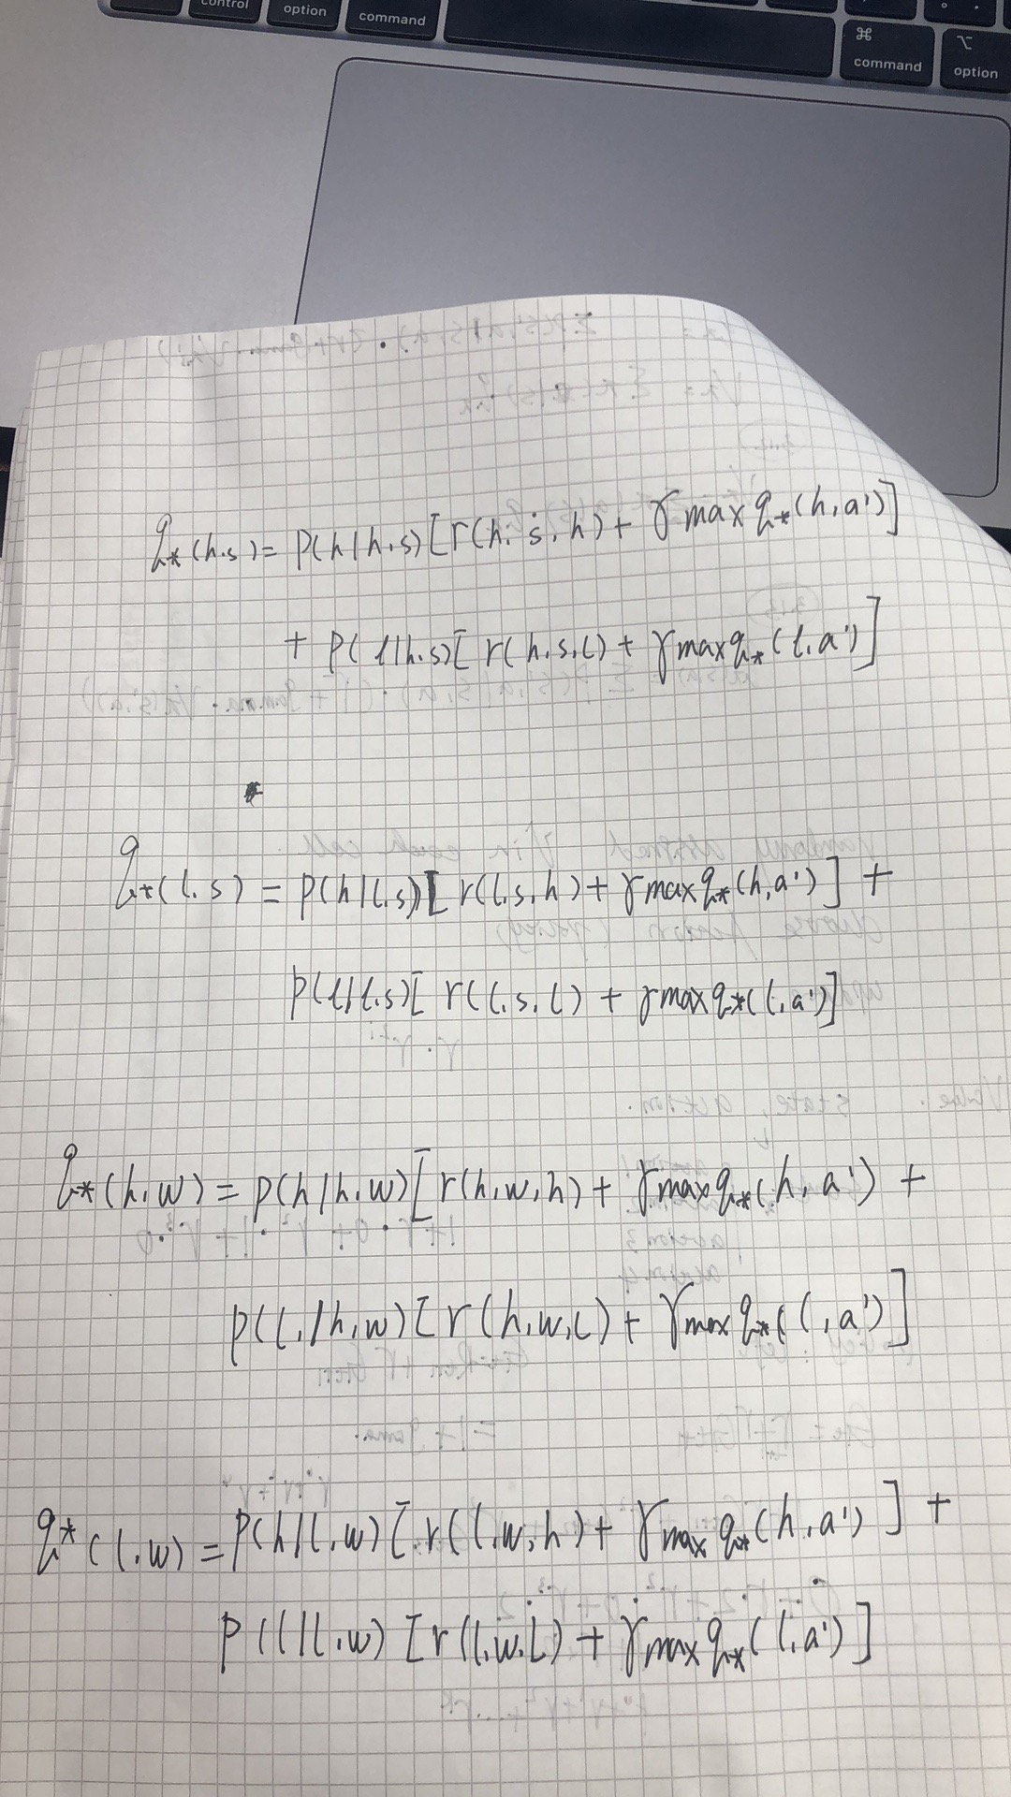
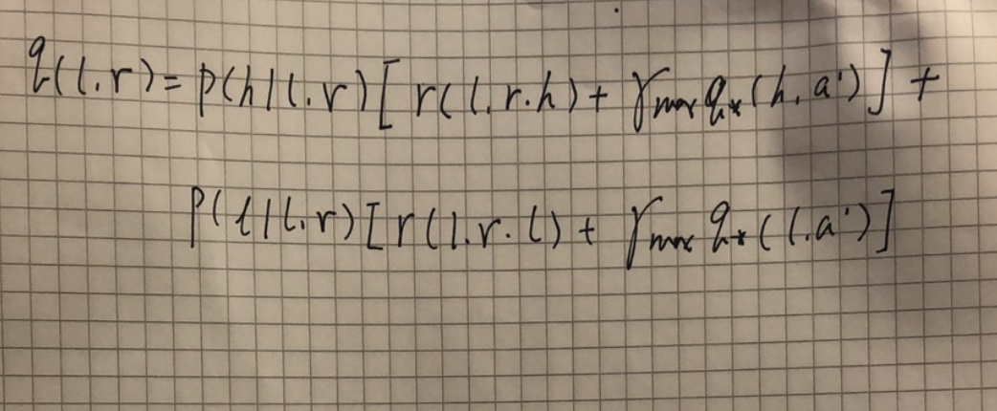

Slide 27
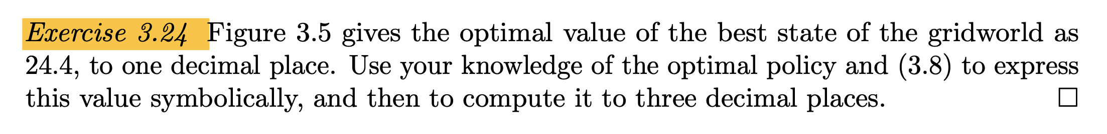
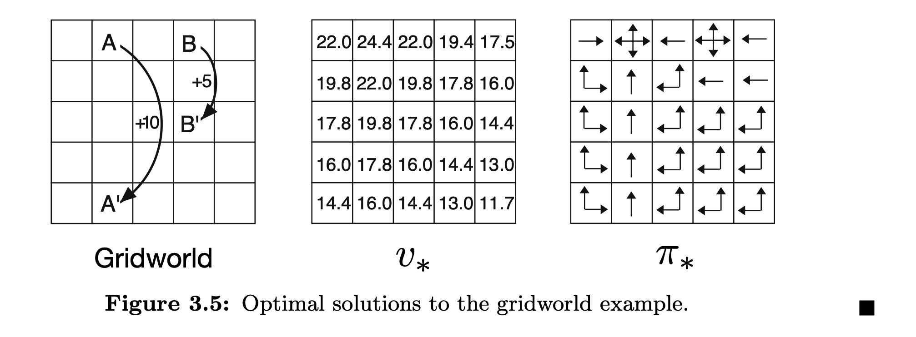

Slide 29
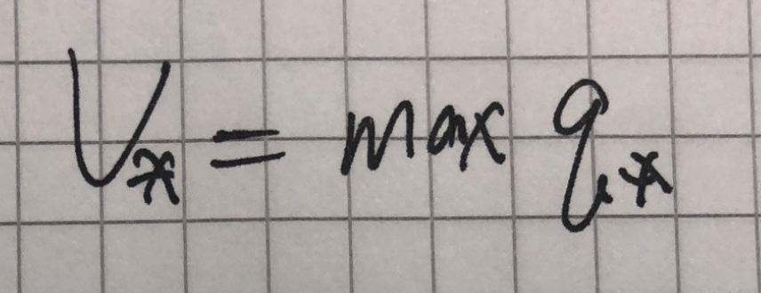

Slide 30
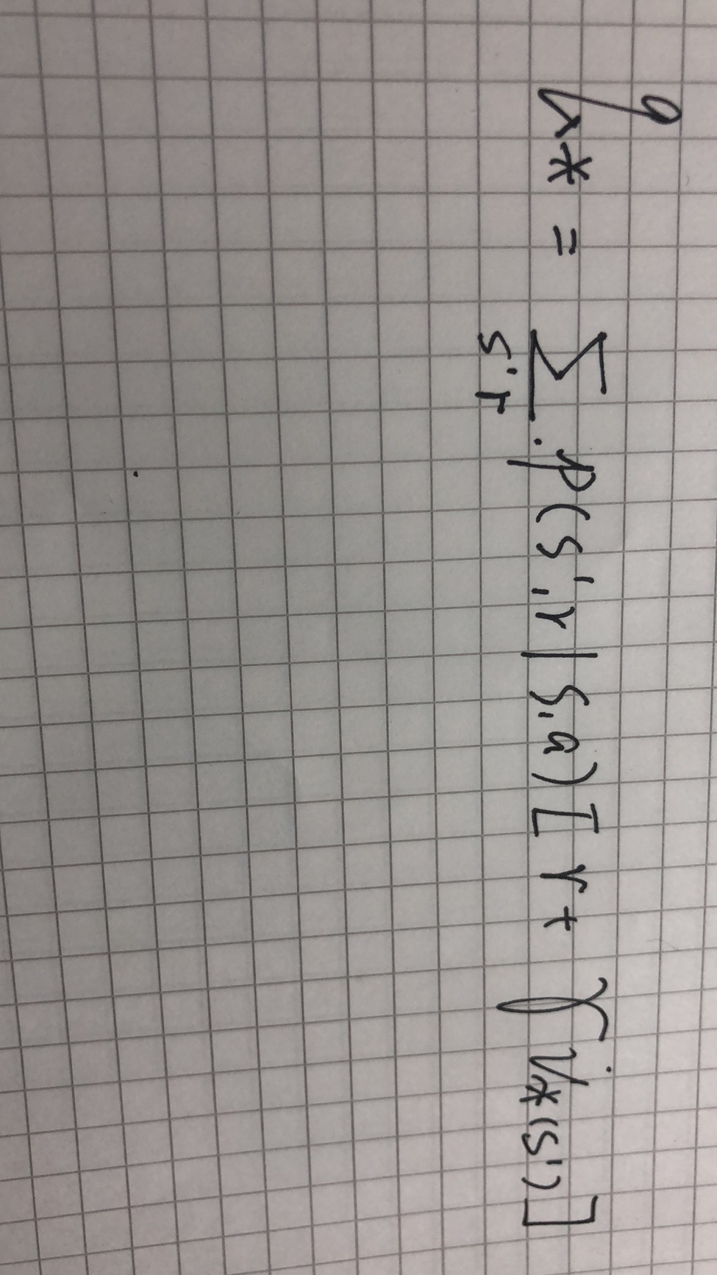

Slide 31
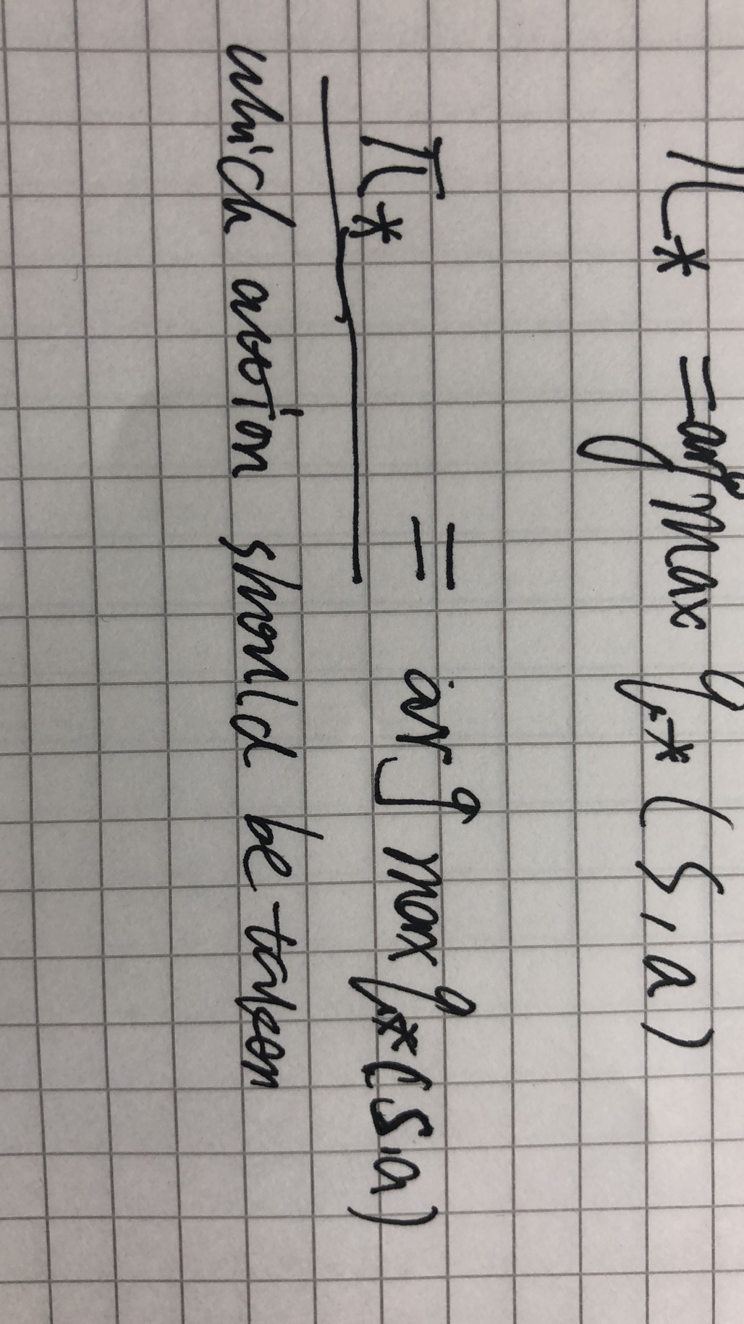

Slide 32
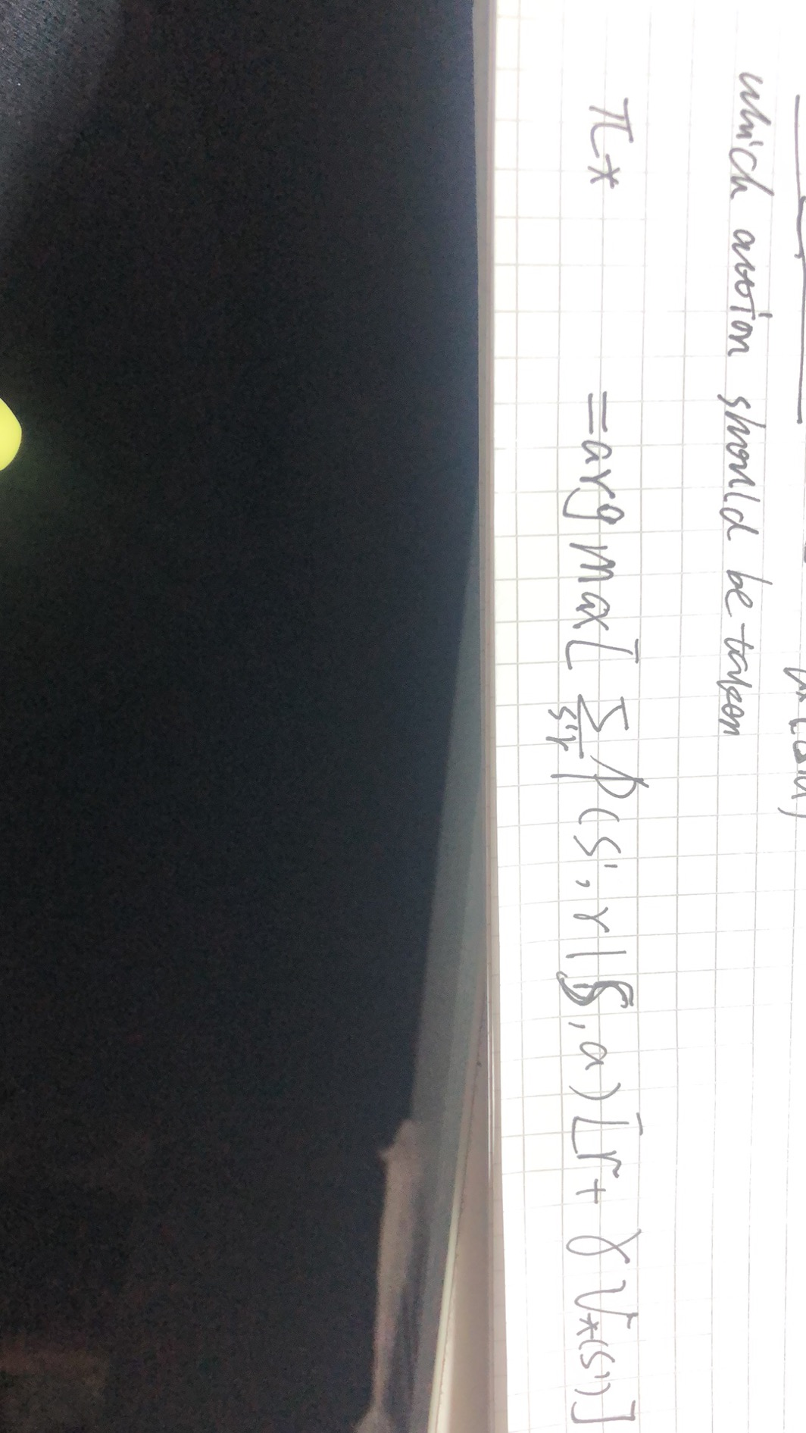

Slide 33
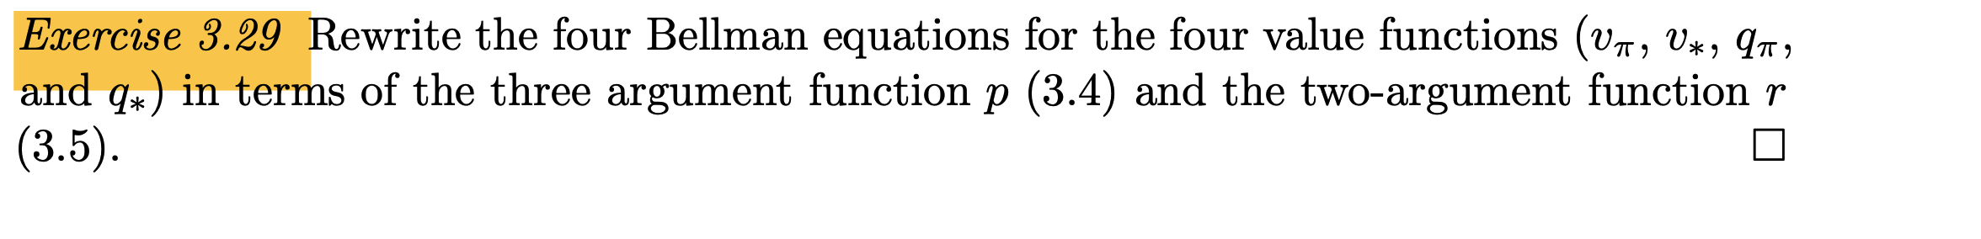
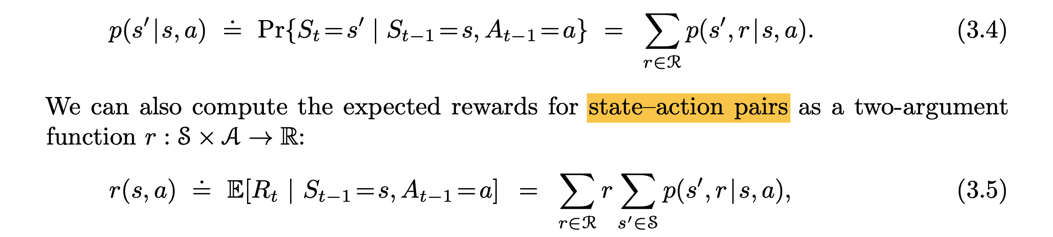

Slide 34
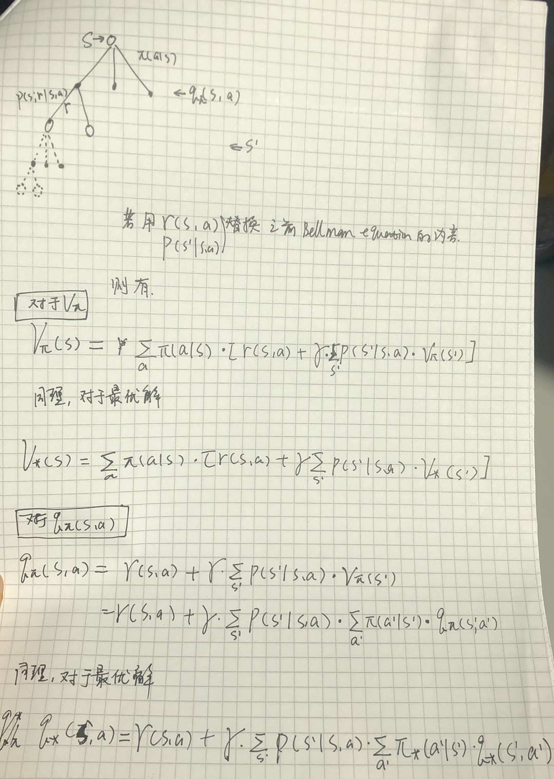

Slide 35
Bonus: solving cliff world question
30 | 31 | 32 | 33 | 34 | 35 | 36 | 37 | 38 | 39
20 | 21 | 22 | 23 | 24 | 25 | 26 | 27 | 28 | 29
10 | 11 | 12 | 13 | 14 | 15 | 16 | 17 | 18 | 19
0 | 1 | 2 | 3 | 4 | 5 | 6 | 7 | 8 | 9
假设所有state的value为 [1,1,1,1]
假设可能的action为 [0,1,2,3] ，分别代表：右，上，左，下
假设learning rate = 0.1
假设gamma = 0.9
假设epsilon = 0.1 （epsilon-greedy algorithm）
假设agent走到红色区域，reward = -100， 且agent必须回到原点0；而走到其他state，reward则为-1；
如果agent碰到墙壁，则state维持不变
假设state transition probability=1，即一旦行动，state transition必然发生。
让我们手算5轮左右，看看value如何update，看看agent会以何种趋势来探索这个“世界”（cliff world）

